Slide 1
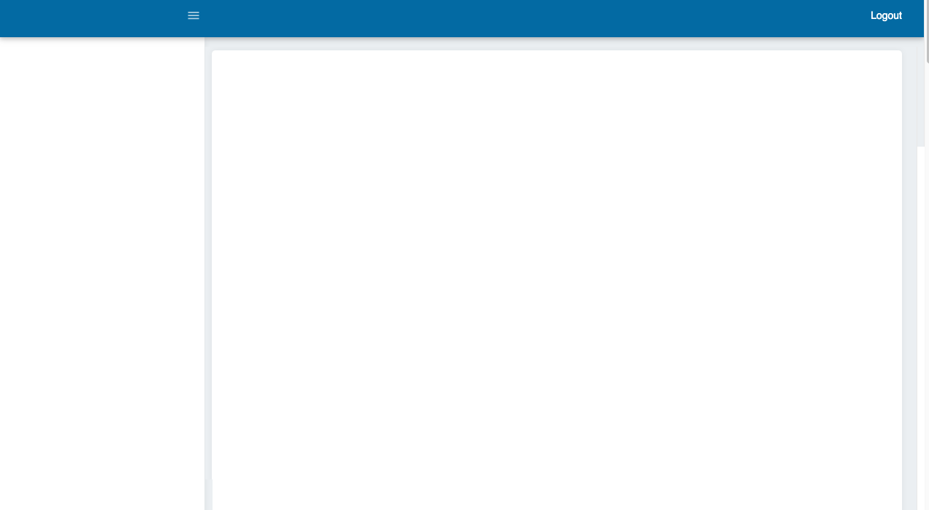
Administration
Create User
Users
Create Collaborator
Collaborators
Create Service
Services
Create Industry
Industries
E-mail template
Projects
Create Project
Project Management
Finance
Projects (€)
Statistics
Sales
Closed Projects
My Statistics
Create User (Form):
Name
Last name
Role (multiple select)
Administrator
Project Manager
Sales
Finance
HR
Phone number
E-mail
Password
CREATE
For login Users will use E-mail & Password

Slide 2
Administration
Create User
Users
Create Collaborator
Collaborators
Create Service
Services
Create Industry
Industries
E-mail template
Projects
Create Project
Project Management
Finance
Projects (€)
Statistics
Sales
Closed Projects
My Statistics
Name | Last name | Role | E-mail | Phone number | Status
Example1 | Example1 | HR,Project Manager | a@a.com | 6000000 | Active
Example2 | Example2 | HR,Project Manager | n@n.com | 6000000 | Not active
Option to edit content or change Status

Slide 3
Administration
Create User
Users
Create Collaborator
Collaborators
Create Service
Services
Create Industry
Industries
E-mail template
Projects
Create Project
Project Management
Finance
Projects (€)
Statistics
Sales
Closed Projects
My Statistics
Create Collaborator (Form):
Name
Last name
Type
Translator (selected by default)
Sworn translator
Copywriting
SEO/Marketer
Video Editor
Other
Source language (language list. Option to select “None”)
Target language (language list. Option to select “None”)
E-mail
Phone number
Rank (integer: 0 by default)
CREATE

Slide 4
Administration
Create User
Users
Create Collaborator
Collaborators
Create service
Services
Create Industry
Industries
E-mail template
Projects
Create Project
Project Management
Finance
Projects (€)
Statistics
Sales
Closed Projects
My Statistics
Name | Last name | Type | Source | Target | Phone number | Status
Example1 | Example1 | Translator | Spanish | English | 6000000 | Active
Example2 | Example2 | SEO | None | None | 6000000 | Not active
Option to edit content or change Status

Slide 5
Administration
Create User
Users
Create Collaborator
Collaborators
Create Service
Services
Create Industry
Industries
E-mail template
Projects
Create Project
Project Management
Finance
Projects (€)
Statistics
Sales
Closed Projects
My Statistics
Create service (Form)
Service name
CREATE

Slide 6
Administration
Create User
Users
Create Collaborator
Collaborators
Create Service
Services
Create Industry
Industries
E-mail template
Projects
Create Project
Project Management
Finance
Projects (€)
Statistics
Sales
Closed Projects
My Statistics
Services
Example1
Example2

Slide 7
Administration
Create User
Users
Create Collaborator
Collaborators
Create Service
Services
Create Industry
Industries
E-mail template
Projects
Create Project
Project Management
Finance
Projects (€)
Statistics
Sales
Closed Projects
My Statistics
Create industry (Form)
Industry name
CREATE
Option to view the Project

Slide 8
Administration
Create User
Users
Create Collaborator
Collaborators
Create Service
Services
Create Industry
Industries
E-mail template
Projects
Create Project
Project Management
Finance
Projects (€)
Statistics
Sales
Closed Projects
My Statistics
Industries
Example1
Example2

Slide 9
Administration
Create User
Users
Create Collaborator
Collaborators
Create Service
Services
Create Industry
Industries
E-mail template
Projects
Create Project
Project Management
Finance
Projects (€)
Statistics
Sales
Closed Projects
My Statistics
HTML editor
Available tags: [name] [ID] [last name] [estimated] [deadline] [service] [industry] [source language] [target language] [attached files] [price] [priceVAT] [notes]
Subject: [ID] - ¡Nuevo proyecto!
¡Hola [Name]!
A continuación un nuevo proyecto de [service]:
[Source language] – [target language]
Cobrarás (IVA inc.): [priceVAT]
Industria: [industry]
Fecha de entrega: [estimated]
Facturación: enviar a contabilidad@shoptexto.com una factura indicando el número de referencia ([ID]). *Aquí puedes verificar los datos de facturación. *Las facturas de la UE (excepto España) deberán mostrarse exentas de IVA (restar el 21% del importe)
Por favor, confirma si te interesa realizar este proyecto de [service].
¡Muchas gracias!
Confirmar
Rechazar
At the momento content is in Spanish. This is the e-mail we will use when assigning a Project. E-mail will be sent when a Project Manager assigns a Project.

Slide 10
Collaborator Accepts/Reject Project
Confirmar
Rechazar
We confirm the action by opening a window
✓ Project confirmed.
Thank you!
You have rejected the offer.
Thanks for letting us know!

Slide 11
Administration
Create User
Users
Create Collaborator
Collaborators
Create Service
Services
Create Industry
Industries
E-mail template
Projects
Create Project
Project Management
Finance
Projects (€)
Statistics
Sales
Closed Projects
My Statistics
Create Project (Form):
ID (created by default, example: SH-N-1000) *where N = first character of the name of a person *1000 = every serie starts with this number
Client (do not use a selector here, only text)
Estimated date (calendar)
Deadline (calendar)
Source language (language list. Option to select “None”)
Target language (language list. Option to select “None”)
Service (select list from “Services”)
Industry (select list from “Industries”)
Billed (without VAT) (integer)
Attach files
Notes
CREATE
Save creation date of all projects

Slide 12
Administration
Create User
Users
Create Collaborator
Collaborators
Create service
Services
Create Industry
Industries
E-mail template
Projects
Create Project
Project Management
Finance
Projects (€)
Statistics
Sales
Closed Projects
My Statistics
Option to order per estimated date, deadline, assignation status, collaborator, cost and Project status
ID | Estimated date | Deadline | Assignation status | Collaborator | Cost (VAT inc.) | Project Status
SH-N-1000 | 05/05/2019 | 08/05/2019 | Pending | Name L. | 110€ | Pending
SH-N-1001 | 05/05/2019 | 08/05/2019 | Pending | - | 0€ | Pending
SH-N-1001 | 05/05/2019 | 08/05/2019 | Confirmed | Name L. | 18€ | Delivered
Option to view the Project

Slide 13
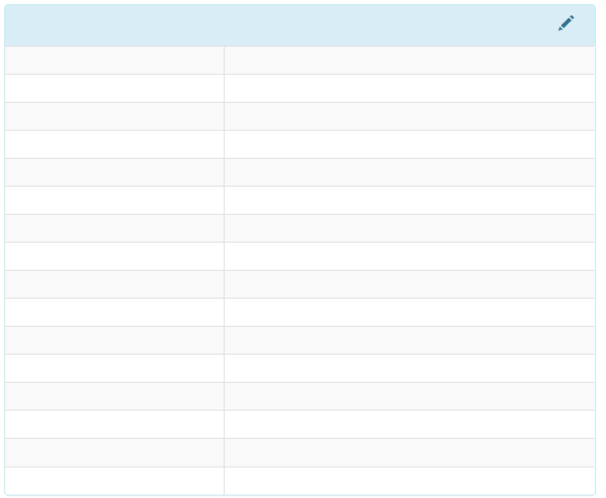
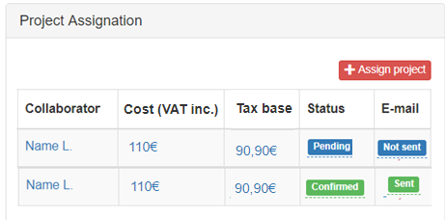
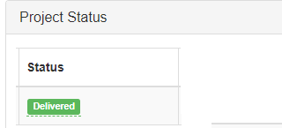
Administration
Create User
Users
Create Collaborator
Collaborators
Create Service
Services
Create Industry
Industries
E-mail template
Projects
Create Project
Project Management
(Project view)
Finance
Projects (€)
Statistics
Sales
Closed Projects
My Statistics
PROJECT DETAILS
ID SH-N-1000
Estimate date 05/05/2019
Deadline 08/05/2019
Service Translation
Source language English
Target language Spanish
Min (VAT inc.) 100€
Max (VAT inc.) 120€
Industry Health
Attached files Downloadable files
Notes File 1 and File 2 contain HTML

Slide 14
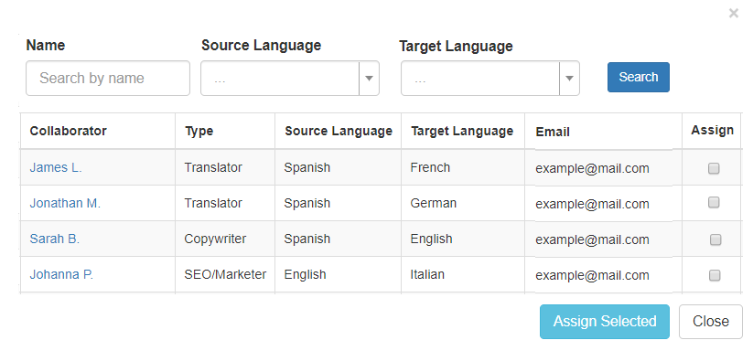
How Project assignation works
Project Manager receives an e-mail with ID of the new Project to assign. “New Project! – ST-N-2000!
Project Manager clicks on “Assign Project” and a Modal appears (collaborators list):
3. Option to select Collaborators and “Assign Selected”. When this is done, an e-mail (check e-mail template) will be sent to the Collaborator.

Slide 15
Administration
Create User
Users
Create Collaborator
Collaborators
Create Service
Services
Create Industry
Industries
E-mail template
Projects
Create Project
Project Management
Finance
Projects (€)
Statistics
Sales
Closed Projects
My Statistics
Option to filter per Client name, User or Payment Status
Option to edit in the table the Payment & Invoice status
Project ID | Client | Billed VAT inc. | VAT | Billed | Margin (€) | Margin (%) | User | Payment status | Invoice status
ST-N-2000 | Name | 10€ | 21% | 8,26€ | 5€ | X% | Name Last name | Charged | Sent
ST-N-2002 | Name | 15€ | 21% | 12,39€ | 8€ | X% | Name Last name | Not charged | Not sent
ST-N-2003 | Name | 20€ | 21% | 16,52€ | 12€ | X% | Name Last name | Charged | Sent

Slide 16
Administration
Create User
Users
Create Collaborator
Collaborators
Create Service
Services
Create Industry
Industries
E-mail template
Projects
Create Project
Project Management
Finance
Projects (€)
Statistics
Sales
Closed Projects
My Statistics
What to show here?
Billed by everyone or filter per user (VAT inc) per month
Billed by everyone or filter per user (no VAT) per month
Number of projects or filterper user closed per month
Average Margin (%)
Total projects
Total collaborators

Slide 17
Administration
Create User
Users
Create Collaborator
Collaborators
Create Service
Services
Create Industry
Industries
E-mail template
Projects
Create Project
Project Management
Finance
Projects (€)
Statistics
Sales
Closed Projects
My Statistics
Option to filter per Client, source/target language. Order per est. date, deadline or Billed
ID | Client | Est. date | Deadline | Source Language | Target Language | Billed | Billet (VAT inc.)
SH-N-1000 | Name | 08/05/2019 | Pending | Spanish | French
SH-N-1001 | Name | 08/05/2019 | Pending | Italian | English
SH-N-1002 | Name | 08/05/2019 | Confirmed | English | German
Option to view the Project

Slide 18
Administration
Create User
Users
Create Collaborator
Collaborators
Create Service
Services
Create Industry
Industries
E-mail template
Projects
Create Project
Project Management
Finance
Projects
Statistics
Sales
Closed Projects
(View of a Project closed)
My Statistics
PROJECT DETAILS
ID SH-N-1000
Estimate date 05/05/2019
Deadline 08/05/2019
Service Translation
Source language English
Target language Spanish
Industry Health
Attached files Downloadable files
Notes File 1 and File 2 contain HTML

Slide 19
Administration
Create User
Users
Create Collaborator
Collaborators
Create Service
Services
Create Industry
Industries
E-mail template
Projects
Create Project
Project Management
Finance
Projects
Statistics
Sales
Closed Projects
My Statistics
Billed by me (VAT inc) per month
Billed by me (no VAT) per month
Number of projects closed per month

Slide 20
Roles & Permissions
Administrator | All
Project Management | Project Management, Project view, Statistics (Finance)
Sales | Create Project, Closed Projects, My Statistics
Finance | Projects, Statistics
HR | Create User, Users

